Slide 1
Maryland NextGen Testbank: Mental Health Mini-Review

Slide 2
NextGen Test Bank Disclosures
This review uses items in the Maryland NextGen Test Bank accessed with a Qualtrics link or QR Code.
The Maryland Testbank contains peer-reviewed items written by faculty across the State of Maryland that attempt to align with publicly available information about Next Generation NCLEX.
The Maryland NextGen Test Bank Project was funded by the Maryland Nursing Workforce Center as part of a grant from the Maryland Higher Education Commission Nurse Support Program II # 20-125.
This review will take approximately 1.5 to 2 hours to complete.
For best result, use a laptop, notebook, or desktop to answer the questions.

Slide 3
About The NextGen NCLEX
Starting April 1, 2023, graduates will take an updated version of the National Council Licensure Exam referred to as Next Generation NCLEX.
Next Generation NCLEX (NGN) will continue to test a candidate’s ability to provide safe client care while incorporating new methods to better test clinical judgment.
The testing methods will include using new item response types in clinical judgment case studies and stand-alone questions to test the NCSBN Clinical Judgment Measurement Model(NCJMM) (https://www.ncsbn.org/exams/next-generation-nclex/NGN+Resources/clinical-judgment-measurement-model.page)

Slide 4
The Five New Item Response Types
Extended multiple response items with increased answer options.
Drag-and-drop items that involve moving options to placeholders.
Drop-down items where candidates select the missing words from sentences, paragraphs, or tables.
Highlight items that require candidates to identify parts of the medical record to answer questions.
Matrix/grid items that involve completing tables of information.

Slide 5
Case Studies
Unfolding case studies use approved NGN item types to answer questions about evolving real-world nursing scenarios.
Case studies present 6 linked questions to test the 6 steps of the NCJMM in order:
Recognize cues
Analyze cues
Prioritize hypotheses
Generate solutions
Take action
Evaluate outcomes
Candidates should expect to complete 3 to 5 case studies in a minimum length 85 question NCLEX exam.

Slide 6
Stand-alone Item Types
Stand-alone (single) items test either client needs or clinical judgment
Client needs items test knowledge of the 8 client needs using traditional or new item types.
Clinical judgment items present information in a clinical scenario specifically targeting one or more NCJMM clinical judgment step.
There are 2 unique types of clinical judgment stand-alone items:
Bowtie
Trend
Clinical judgment stand-alone items make up approximately 10% of stand-alone items.

Slide 7
Stand-alone Item: Bowtie
A bowtie is a drag-and-drop response item variation.
After reading a clinical scenario, candidates move response options (tokens) to placeholders (targets).
On NCLEX the placeholders are arranged in the shape of a bowtie.
Candidates must select:
1 condition the client is most likely experiencing from 4 options.
2 actions to take to address the condition from 5 options.
2 parameters to monitor the client’s progress from 5 options.

Slide 8
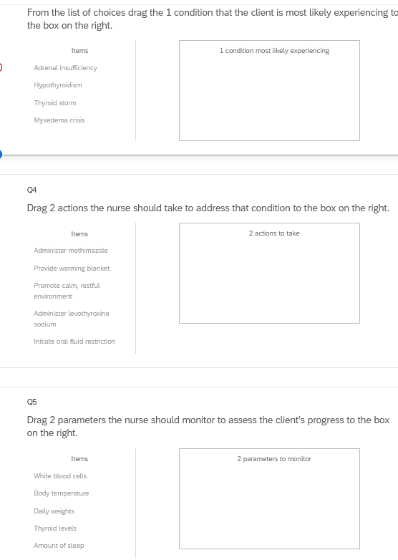
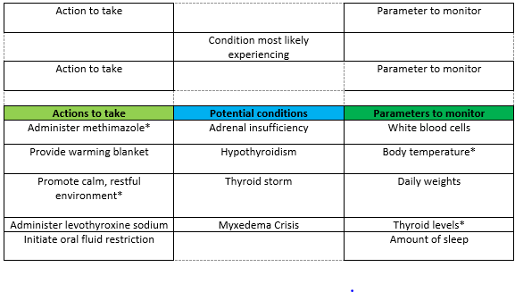
Bowties in Qualtrics
Bowties in Qualtrics are 3 drop and drag question- but they don’t make a “bowtie” shape.

Slide 9
Stand-alone Item: Trends
Trend items require the candidate to make clinical judgments based on client data presented at different time points.
Trend items may address one or more clinical judgment steps but do not follow the six-item sequence like case studies do.
Trend items can feature any item response type except bowtie.

Slide 10
About This Review
Your instructor will provide a QR code or link to answer a series of case studies, bowtie items and trends across a lifespan
While questions throughout the test bank use all 5 new item response, not all specific variations that might be used on NCLEX are not included such as drop-down items formatted as a table.
Information needed to answer questions will be displayed in a medical record, but the medical record will display differently on the actual NCLEX.
To see how items will exactly appear on NCLEX see tutorials at https://nclex.com/next-generation-nclex.page

Slide 11
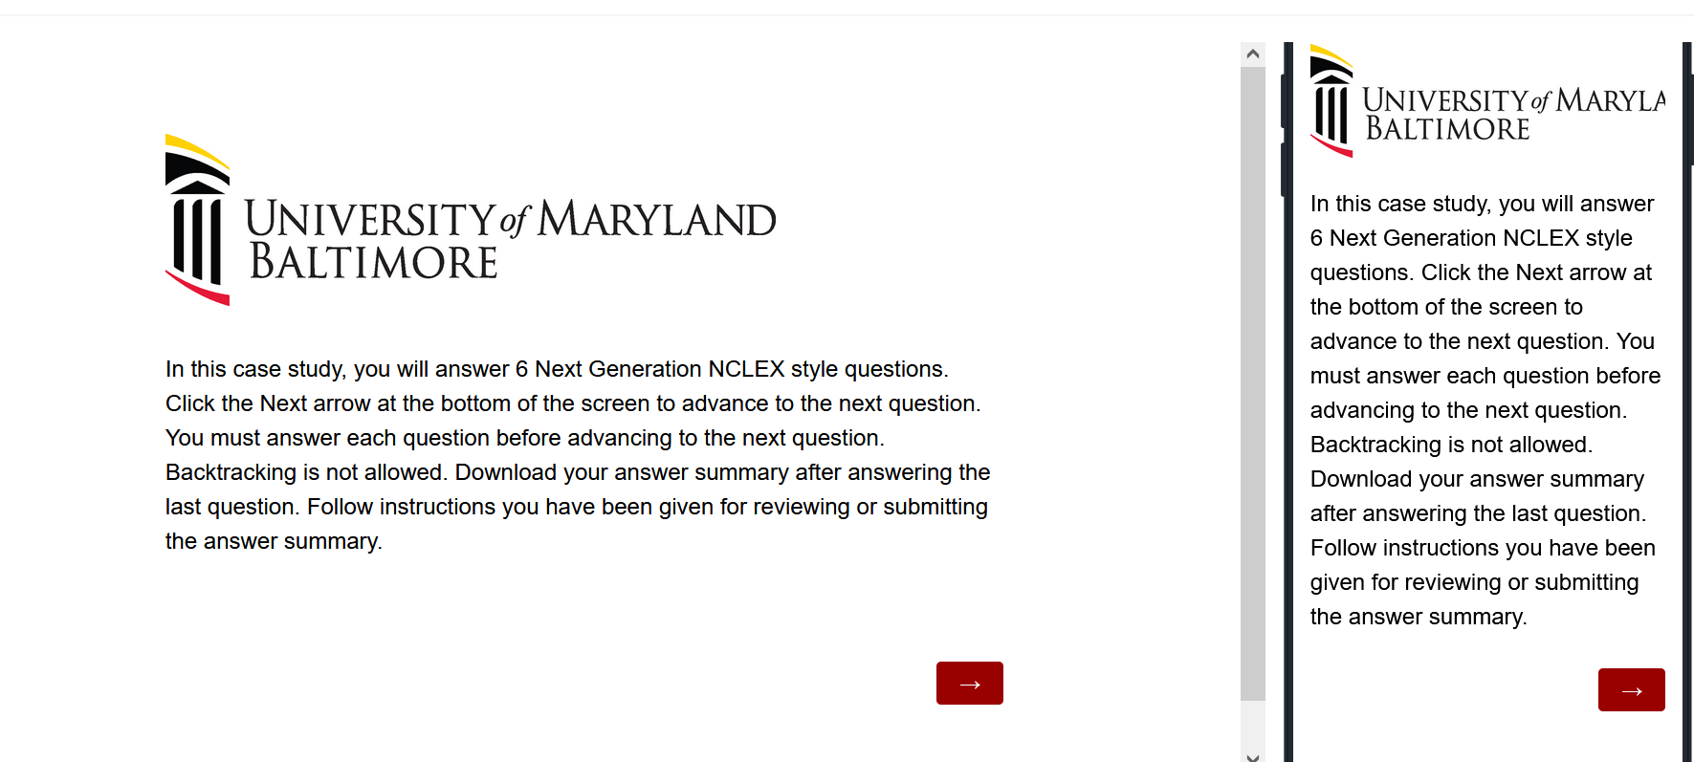
The First Screen Provides Instructions
Use the arrow to advance the screens
There is no backtracking

Slide 12
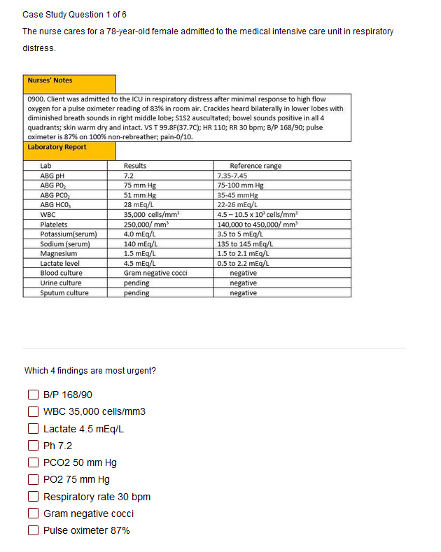

Answer the Questions
Read the instructions carefully.
Sometimes the question tells how many options to pick.
Other times you select all that apply.
Some questions will not allow you to advance if they have not answered enough options.
Use the arrow to advance to the next question if doing a case study

Slide 13
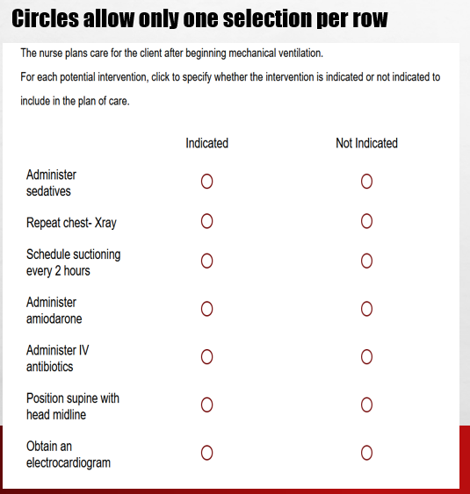
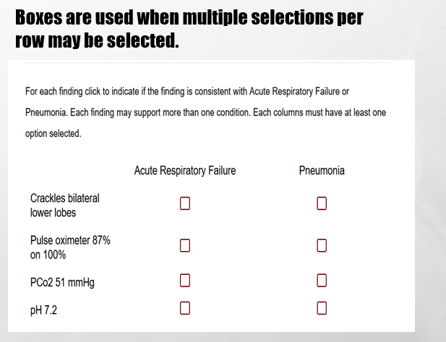
In Tables, Follow Instructions for How Many Options May be Selected in a Row.

Slide 14
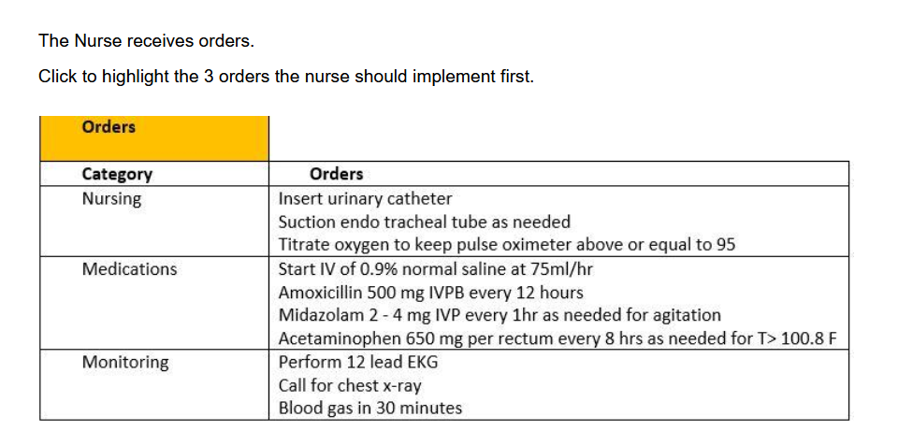
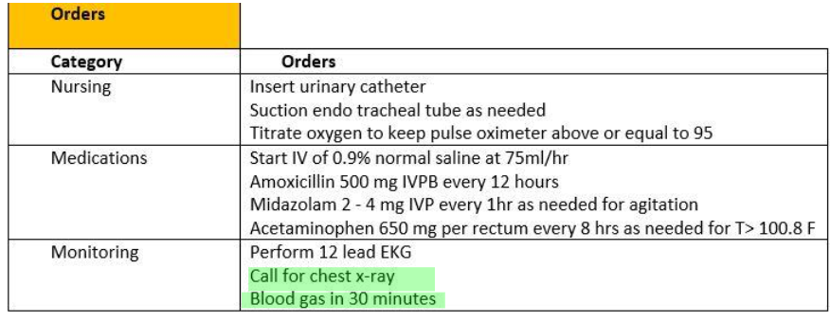
Highlight Questions
Questions first show a plain EMR page
Hovering curser makes boxes appear around selectable data
Click the box to apply the highlight; A second click removes it.

Slide 15
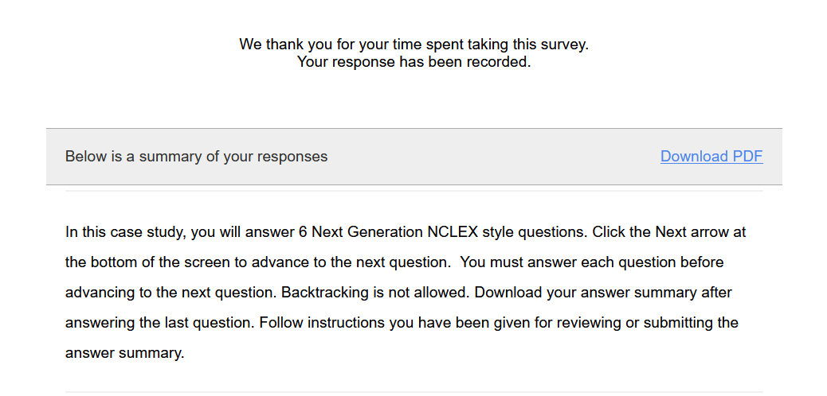
Submit the Final Question and Click Download PDF from Thank You Screen
It is the only way to save your answers.
This step is critical!

Slide 16
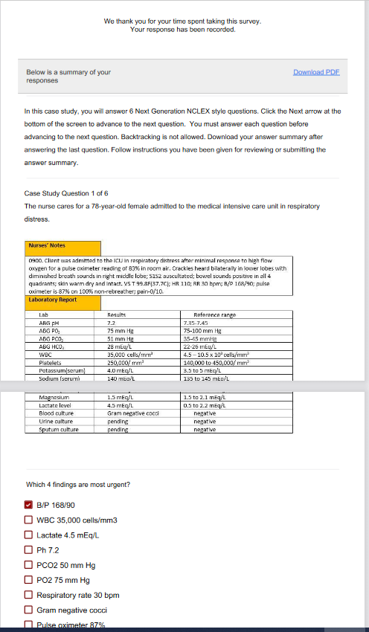
The Response Summary Shows Your Answers
Follow your faculty’s instructions for saving the response summary.
They may have you print it out, save it to computer, or upload it to a learning management system.
The response summary DOES NOT give you the correct answers.
Answers will appear on subsequent slides with information on how to score the item and a rationale for the answer.

Slide 17
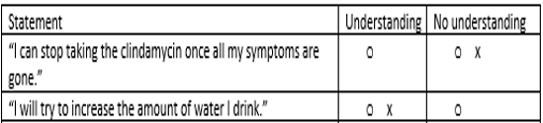
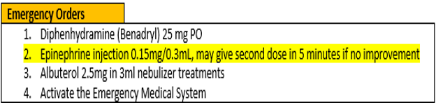
Correct Answers
Correct answers may be indicated 1 of 4 ways
Asterisk appears after correct option*
Option may be underlined with or without an *
Option may appear as an X or * in a table
Correct answer may appear as highlight

Slide 18
New Scoring Rule: +/-
Used when takers may pick unlimited options
Possible points are number of keyed correct items
Earn 1 point for each correct item selected
Loose 1 point for each incorrect item selected
Guessing penalty prevents takers from gaming system by selecting all
Minimum score =0
Which items are viruses? Select all that apply.
■ Chlamydia
■ Influenza[✓]
■ Hepatitis B [✓]
Lyme disease
Pertussis
Tuberculosis
Varicella [✓]
+/- Scoring rule
3 points possible
+2 correct
-1 incorrect
-----------------
1 points

Slide 19
New Scoring Rule: 0/1
Used when takers may select limited options
Possible points are number of keyed correct items
Earn 1 point for each correct item selected
Earn 0 points for incorrect responses
Minimum score 0
Which 3 items are viruses?
■ Chlamydia
■ Influenza[✓]
■ Hepatitis B [✓]
Lyme disease
Pertussis
Tuberculosis
Varicella [✓]
0/1 Scoring rule
3 points possible
+2 correct
-----------------
2 points

Slide 20
Same Answers: Different Scores
Select all that apply
Which 3 items are viruses?
■ Chlamydia
■ Influenza[✓]
■ Hepatitis B [✓]
Lyme disease
Pertussis
Tuberculosis
Varicella [✓]
Which items are viruses? Select all that apply
■ Chlamydia
■ Influenza[✓]
■ Hepatitis B [✓]
Lyme disease
Pertussis
Tuberculosis
Varicella [✓]
0/1 Scoring rule
3 points possible
+2 correct
-----------------
2 points
+/- Scoring rule
3 points possible
+2 correct
-1 incorrect
-----------------
1 point

Slide 21
Rationale Scoring Rule
Complete the sentence from list of dropdown options.
To prevent night blindness the nurse would recommend
because they are rich in vitamin
Used when question has linked concept and a justification in the same sentence
Example: The client most likely has an asthma exacerbation as evidenced by the breath sounds.
Dyad worth 1 point
One cause and one effect
Both parts must be correct for credit
Triad worth 2 points
One cause 2 effects
Cause must be right for any credit
Partial credit given (1 point) if only 1 effect is correct
almonds
carrots✓
orange juice
A
B
C✗
Right condition,
Wrong justification =0 points

Slide 22
Keep track of your score as you move through the review
Item | My score
Case study 1
Trend 1
Case study 2
Trend 2
Bowtie 1
Case study 3
Total Points

Slide 23
Final Link
The final link in the review takes you to the course evaluation.
This anonymous information will be used to help us understand how this review is being used and how to improve the experience.

Slide 24
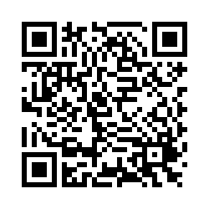
Case Study # 1
URL
QR Code
https://umaryland.az1.qualtrics.com/jfe/form/SV_3eKszlC4xNo4CJE
Take about 10 minutes

Slide 25
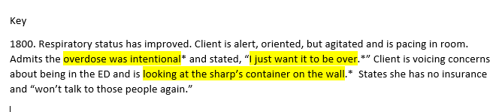
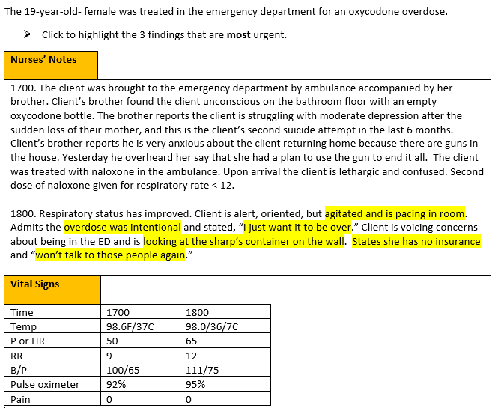
Screen 1 of 6
+/-. This question is worth 3 points. Give yourself 1 point for each correct response AND
subtract 1 point for every incorrect answer you picked . The worst you can score is 0.
6 statements are selectable

Slide 26
Rationale
The priority concern for this client is safety. The RN should immediately follow up with the brother’s statement about guns being in the house and the client having an active plan to use them to cause harm. The RN should also be concerned about access to the sharps box with her recent suicide attempt and the client’s statement of wanting to end her life.

Slide 27
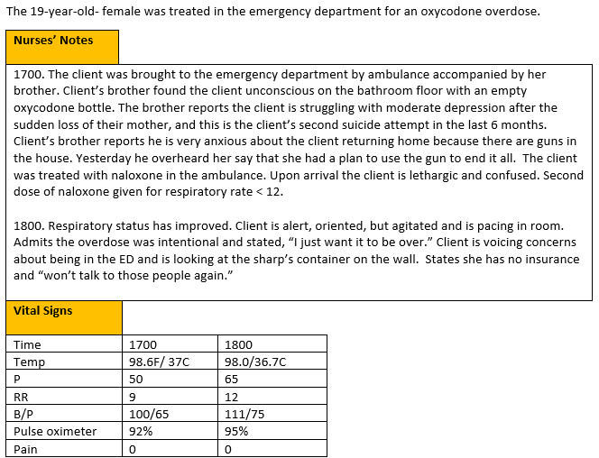
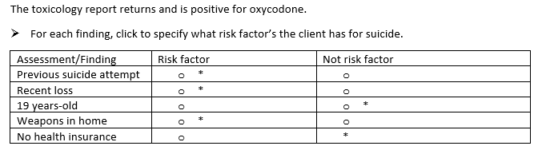
Screen 2 of 6
0/1. This question is worth 5 points.
Give yourself 1 point for each row you got correct.

Slide 28
Rationale
Per the CDC, risk factors for suicide include previous suicide attempts, mental illness such as depression, substance use disorder, relationship problems such as a loss, etc.

Slide 29
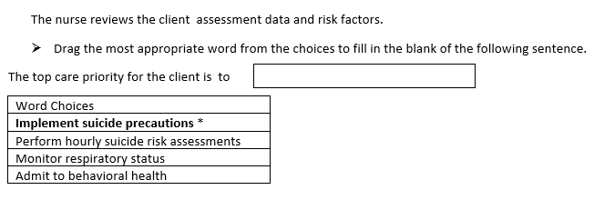
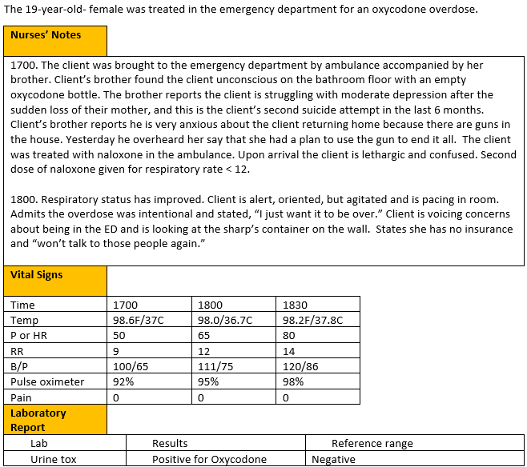
Screen 3 of 6
0/1. This question is worth 1 point.
Give yourself 1 point if you answered correctly.

Slide 30
Rationale
The client is presenting with several safety concerns, and it is crucial to keep them safe. While it is important to continue suicide risk assessments, it is clear the client is presenting with immediate safety needs related to suicidal comments and behaviors and suicide precautions must be implemented. Hourly suicided assessments are not sufficient.

Slide 31
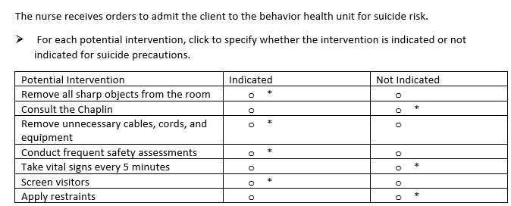
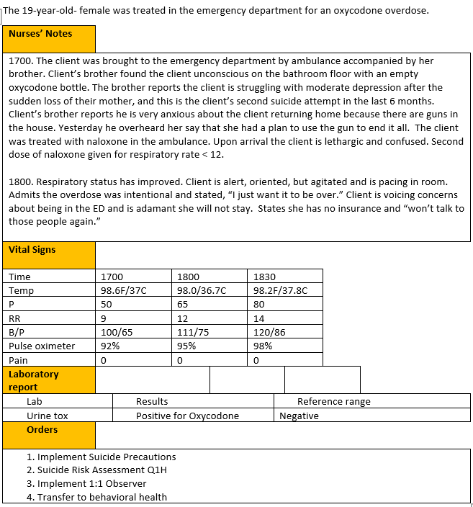
Screen 4 of 6
0/1. This item is worth 7 points. Give yourself 1 point for every row you got right.

Slide 32
Rationale
The room should be prepared with limited linen, removal of all sharp objects, and removal of unnecessary cables, cords, and equipment when a client is on suicide precautions. There is not necessarily a restriction on staff or visitors. Visitors should be screened, and a Chaplin can be consulted per the client request. It is important to conduct frequent safety assessments, but vital signs every 5 minutes and restraints are not necessary currently.

Slide 33
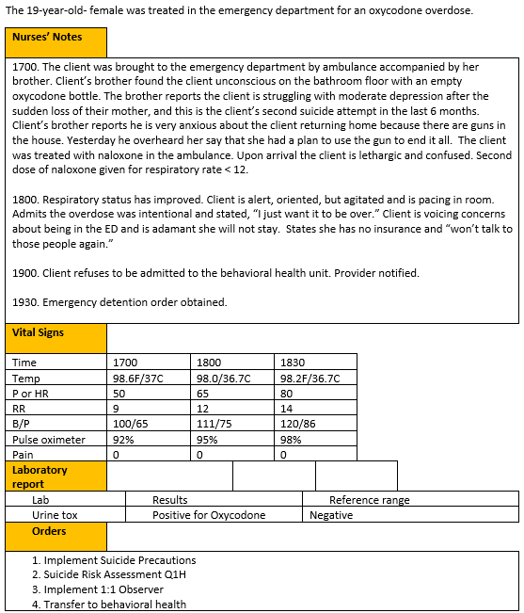
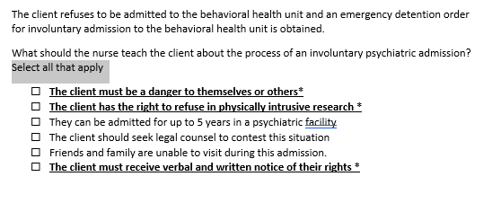
Screen 5 of 6
The
+/-. This item is worth 3 points. Give yourself 1 point for every correct selection AND subtract 1 point for every incorrect item you selected. The worst you can score is 0.

Slide 34
Rationale
An involuntary psychiatric admission is granted when a client is a danger to themselves or others and if a client is unwilling to be admitted. The client must be given verbal and written information within 12 hours stating the reason for the involuntary admission, availability of legal services and their right to talk to a lawyer. Clients retain the right to be cared for in the least restrictive environment and the right to refuse to participate in any form of human subject’s research.

Slide 35
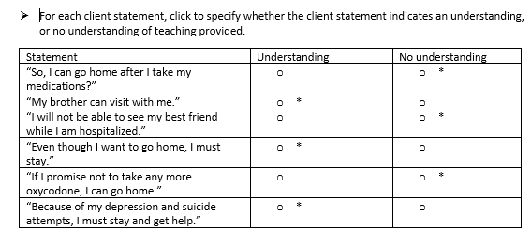
Screen 6 of 6
The
0/1. This item is worth 6 points. Give yourself 1 point for every row you got right.

Slide 36
Rationale
The client verbalizes understanding when she states her brother can visit with her, friends and family are not limited to visitation. The client verbalizes understanding that even though she wants to be discharged, legally she will be admitted against her wishes due to her history of depression and suicide attempts.

Slide 37
Case Study 1 Score
Question | Possible | My score
1 | 3
2 | 5
3 | 1
4 | 7
5 | 3
6 | 6
Total | 25

Slide 38
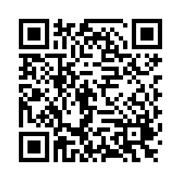
Trend # 1
URL
QR Code
https://umaryland.az1.qualtrics.com/jfe/form/SV_eCCgXepP22LEcHI
Take 2-3 minutes

Slide 39
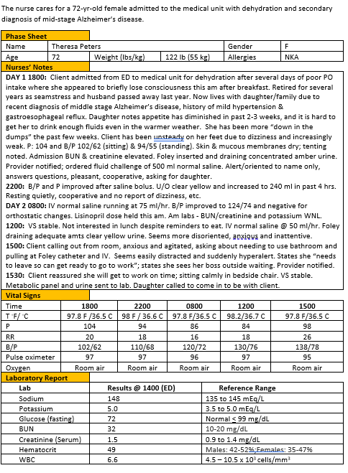
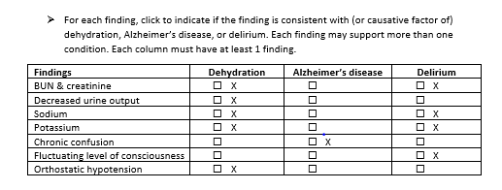
+/-. This item is worth 10 points. Score each column separately first and then add columns scores together. Score 1 point for each correct response AND subtract 1 point for each incorrect answer. The worst you can score is 0 per column.
Dehydration= 5 points
Alzheimer’s disease = 1 point
Delirium= 4 points

Slide 40
Rationale
Rising levels of BUN/creatinine and sodium/potassium are linked to both dehydration and consequently, a metabolic trigger for delirium. Decreased urine output is more directly linked to dehydration. Orthostatic hypotension can be a symptom of dehydration/fluid volume deficit. Chronic confusion is a sign of Alzheimer’s disease/dementia but fluctuating LOC and perceptual disturbances/hallucinations are indicative of delirium. Persons with dementia are generally in steady state of alertness until very late in the illness, or, if experiencing delirium superimposed on dementia.

Slide 41
Trend 1 Score
Question | Possible | My score
Points | 10

Slide 42
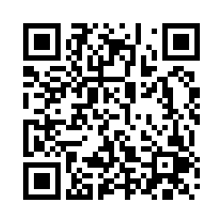
Case Study # 2
URL
QR Code
https://umaryland.az1.qualtrics.com/jfe/form/SV_8xqOoOkDqOiQSgK
Take about 10 minutes

Slide 43
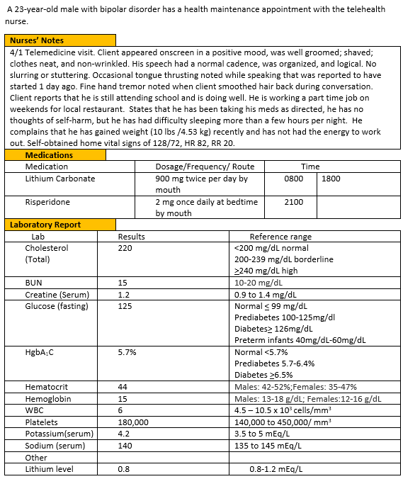
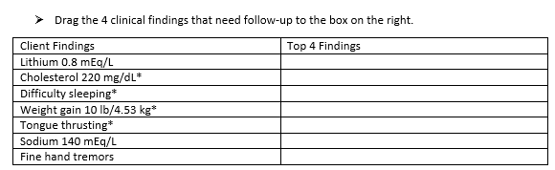
Screen 1 of 6
0/1. This question is worth 4 points.
Give yourself 1 point for each correct response.

Slide 44
Rationale
Tongue thrusting is an extrapyramidal adverse effect caused by risperidone (Burcham & Rosenthal, 2022). This is an adverse effect of the second-generation antipsychotic risperidone. Other metabolic adverse effects include weight gain, hyperlipidemia, and hyperglycemia (Burcham & Rosenthal, 2022). Other concerning issues include the patient’s inability to sleep. Sleep disturbance is a core symptom of bipolar disorder (Roloff et al , 2022). A fine hand tremor is concerning since the client is on lithium, but it is a common side effect and not a top priority.

Slide 45
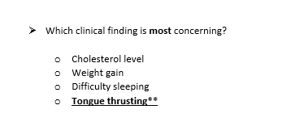
Screen 2 of 6
0/1. This question is worth 1 point.
Give yourself 1 point if you got this right.

Slide 46
Rationale
Some factors require immediate attention – such as tongue thrusting – since it is an adverse effect of risperidone. This is an extra pyramidal symptom (EPS). If this symptom is not reported early and managed, it can be irreversible (Burcham & Rosenthal, 2022). Other factors, like metabolic adverse effects of risperidone (HgbA1C, weight gain) may occur and should be evaluated, but do not require immediate attention (Burcham & Rosenthal, 2022). Fatigue or difficulty sleeping should be monitored since this could be an indication of depression.

Slide 47
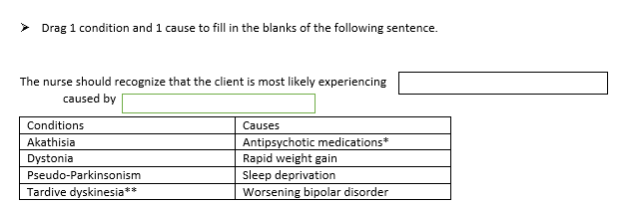
Screen 3 of 6
Rationale. This question is worth 1 point.
Give yourself 1 point only if you BOTH parts correct.

Slide 48
Rationale
Tongue thrusting is an extrapyramidal symptom, which can be caused by antipsychotic medications, that can be irreversible if not identified early in therapy. (Burchum & Rosenthal, 2022). Other EPS symptoms include akathisia, acute dystonia and pseudo-Parkinsonism.

Slide 49
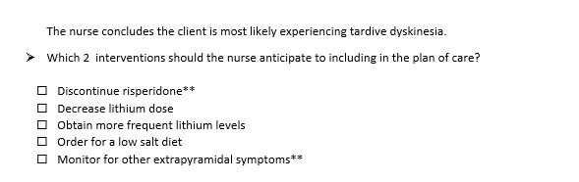
Screen 4 of 6
0/1. This item is worth 2 points. Give yourself 1 point for every correct option selected.

Slide 50
Rationale
Due to the serious adverse effects of risperidone, the nurse should expect that the drug be discontinued. This client requires maintenance treatment for bipolar disorder and monotherapy with lithium, a mood stabilizer, is usually sufficient. If the patient experiences a manic episode, a different antipsychotic, besides risperidone, might be prescribed ( Micromedex, 2022). The nurse should monitor for other adverse effects (Burchum & Rosenthal, 2022).

Slide 51
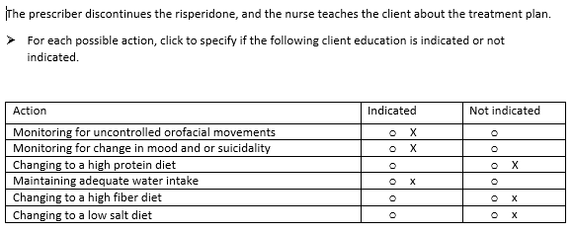
Screen 5 of 6
The
0/1. This item is worth 6 points. Give yourself 1 point for every row you got right.

Slide 52
Rationale
The client has to be monitored for the frequency of tardive dyskinesia (uncontrolled orofacial movements) to see if the tardive dyskinesia is subsiding. The nurse should also teach the client and family to monitor for bipolar symptoms (e.g., depressive symptoms and or suicidality or symptoms of mania). Since the client will be maintained on lithium, which has a very narrow therapeutic index, the client and family must monitor for adverse effects indicative of toxicity. Hydration status is key to maintaining a stable lithium concentration and changes in sodium or hydration status can lead to therapeutic excess or failure (Burcham & Rosenthal, 2022).

Slide 53
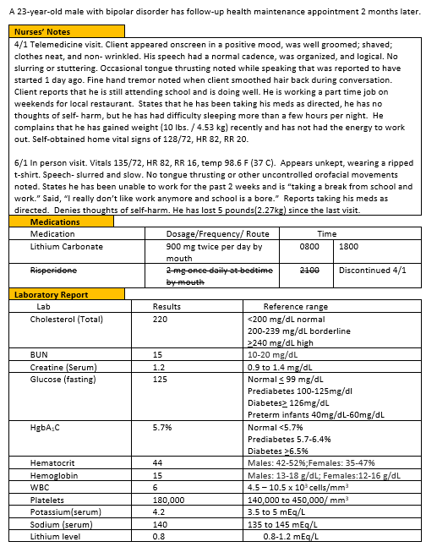
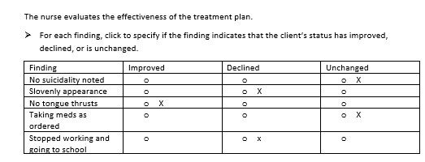
Screen 6 of 6
The
0/1. This item is worth 6 points. Give yourself 1 point for every row you got right.

Slide 54
Rationale
In reviewing the client’s status, the patient appears to be improving in some manner (no more tardive dyskinesia) but his appearance and stopping school may indicate that his mental status may have declined. The nurse should evaluate the client to determine if the findings indicate depression.

Slide 55
Case Study 2 Score
Question | Possible | My score
1 | 4
2 | 1
3 | 1
4 | 2
5 | 6
6 | 5
Total | 19

Slide 56
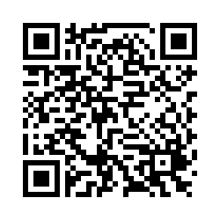
Trend # 2
URL
QR Code
https://umaryland.az1.qualtrics.com/jfe/form/SV_1ZWLVGzQ7xJNi86
Take 2-3 minutes

Slide 57
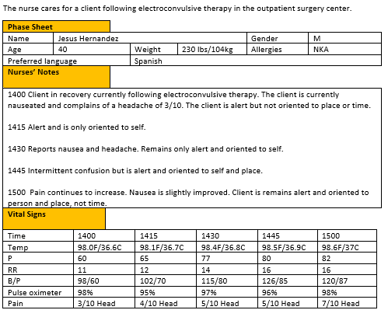
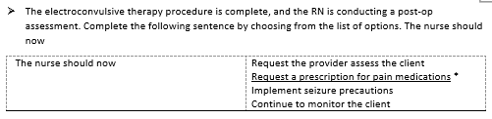
This item is worth 1 point. Give yourself 1 point if you got it correct.

Slide 58
Rationale
Nausea, confusion, memory loss, and headache are all common side-effects minutes to hours after the ECT procedure. It is important the RN addresses the client’s pain level and ensure the client has pain medications for discharge.

Slide 59
Trend 2 Score
Question | Possible | My score
Points | 1

Slide 60
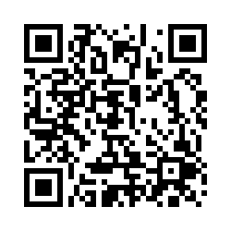
Bowtie # 1
URL
QR Code
https://umaryland.az1.qualtrics.com/jfe/form/SV_8hKflnpqaiatOuy
Take 2-3 minutes

Slide 61
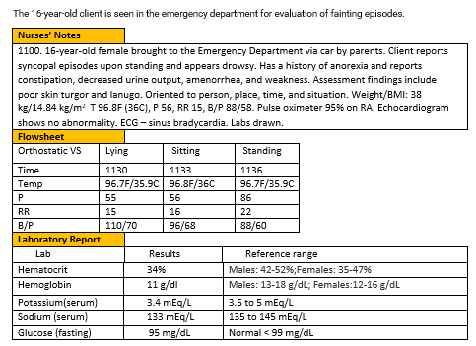
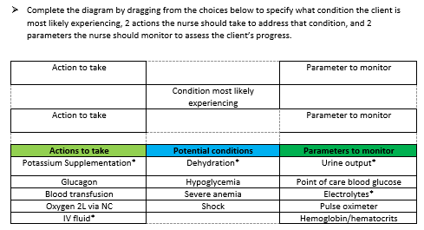
This item is worth 5 points. Give yourself 1 point for every answer you got it correct.

Slide 62
Rationale
The client is most likely experiencing dehydration. There is no evidence of severe anemia, hypoglycemia or shock at this time. The client needs potassium supplementation and IV fluids to correct the fluid and electrolyte imbalance. The client does not need a blood transfusion at this time, oxygen levels are stable, and no oxygen is needed. Urine output will need to be monitored to assess improved fluid balance. Blood glucose does not need to be checked as the client has no signs of hypoglycemia. Pulse oximetry is not needed as this is stable. The client needs routine electrolyte monitoring but there is no need to monitor hemoglobin and hematocrit as this is stable.

Slide 63
Bowtie 1 Score
Question | Possible | My score
Points | 1
Actions | 2
Parameters | 2
Totals | 5

Slide 64
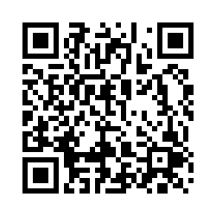
Case Study # 3
URL
QR Code
https://umaryland.az1.qualtrics.com/jfe/form/SV_1YA9vfuYdouYWVM
Take about 10 minutes

Slide 65
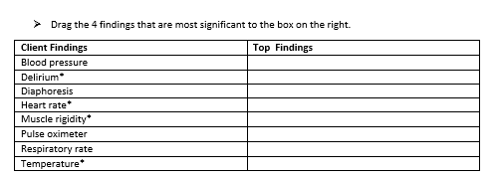
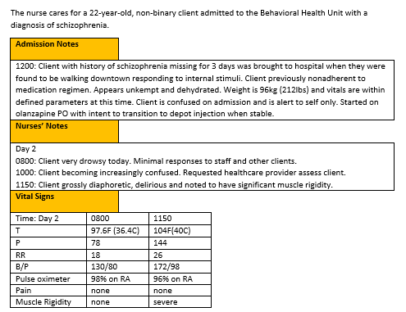
Screen 1 of 6
0/1. This question is worth 4 points.
Give yourself 1 point for each correct response.

Slide 66
Rationale
The client is presenting with several serious symptoms. The symptoms which are most significant are the sudden fever, muscle rigidity, delirium, and irregular tachycardic heart rate. The diaphoresis is significant but can be explained by a high fever. The respiratory rate is mildly elevated but not life threatening. The pulse oximeter is normal.

Slide 67
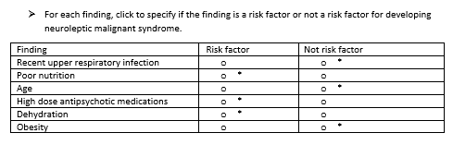
Screen 2 of 6
0/1. This question is worth 6 points.
Give yourself 1 point for each row you got correct.

Slide 68
Rationale
Risk factors for neuroleptic malignant syndrome include high dose antipsychotic medications, dehydration, and poor nutrition. Age, obesity, and mild illness are not risk factors would not contribute to neuroleptic malignant syndrome.

Slide 69
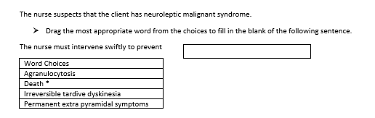
Screen 3 of 6
0/1. This question is worth 1 point.
Give yourself 1 point if you answered correctly.

Slide 70
Rationale
Though rare, neuroleptic malignant syndrome can be fatal. The client vitals and labs indicate that the client is declining rapidly. Tardive dyskinesia is not life-threatening and is characterized by involuntary facial movements. Extra pyramidal symptoms can be fatal and characterized by involuntary movements not hyperthermia. Agranulocytosis is a low white blood cell count. It does not cause muscle rigidity.

Slide 71
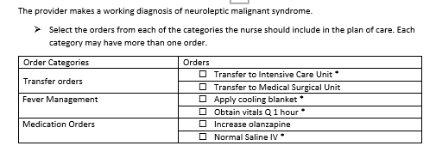
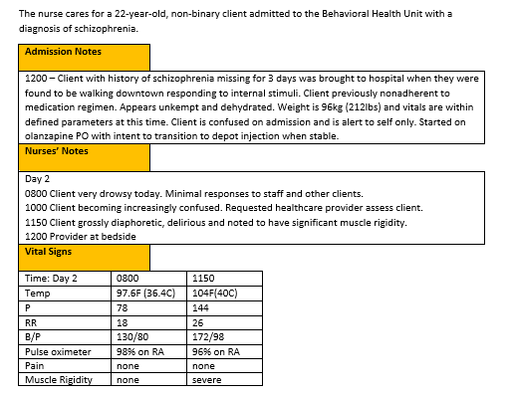
Screen 4 of 6
+/-. This item is worth 4 points- Score each category separately then add scores together. Score 1 point for each correct response AND subtract 1 point for each incorrect answer. The worst you can score is 0 per category.
Transfer= 1 point
Fever management= 2 points
Medications= 1 point

Slide 72
Rationale
The client is experiencing a medical emergency. Transfer to ICU, cooling blanket, and frequent vital signs are appropriate. The olanzapine and dehydration likely caused the neuroleptic malignant syndrome. The olanzapine should be stopped, and IV normal saline started.

Slide 73

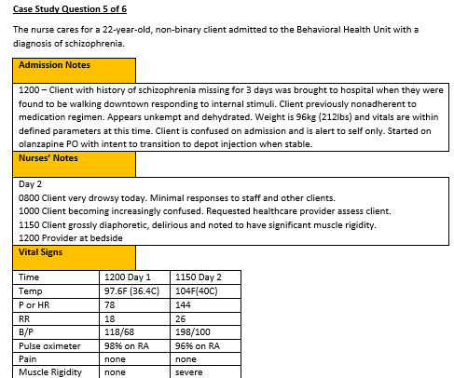


Screen 5 of 6
The
+/-. This item is worth 3 points. Give yourself 1 point for every correct option highlighted AND subtract 1 point for every incorrect item you selected. The worst you can score is 0.

Slide 74
Rationale
: The olanzapine must be stopped immediately as this is what caused the neuroleptic malignant syndrome. The hyperthermia must immediately be addressed by the addition of cooling measures. Starting the IV is critical to prevent dehydration from the fever and diaphoresis and to establish access for giving medications. A creatine kinase value will help guide treatment, but obtaining one is not as critical as implementing supportive care. Treating the muscle rigidity is lower priority that treating the high fever and cannot be done until the IV is started. The urine must be monitored and documented but placing the foley is not the highest priority.

Slide 75


Screen 6 of 6
The
Rationale. This item is worth 1 point. Give yourself 1 point only if you got BOTH parts correct.

Slide 76
Rationale
The client verbalizes understanding when she states her brother can visit with her, friends and family are not limited to visitation. The client verbalizes understanding that even though she wants to be discharged, legally she will be admitted against her wishes due to her history of depression and suicide attempts.

Slide 77
Case Study 3 Score
Question | Possible | My score
1 | 4
2 | 6
3 | 1
4 | 4
5 | 3
6 | 1
Total | 19

Slide 78
My Total
Item | Possible Points | My score
Case study 1 | 25
Trend 1 | 10
Case study 2 | 19
Trend 2 | 1
Bowtie 1 | 5
Case study 3 | 19
My Score | 79

Slide 79

Please Complete the Mini Review Evaluation
https://umaryland.az1.qualtrics.com/jfe/form/SV_1ZYu3gxvlMDziMS
This evaluation will take approximately less than 2 minutes to complete.

